Slide 1
Cyber Security Operations Center (CSOC) Project
Building a Prototype and Production Infrastructure for SMEs
Team Members: Archie, Amber, Anthony, Flynn, Michael

Slide 2
Project Overview
Goal
Step 1
Step 2
Step 3
Our objective: to develop a prototype cybersecurity model (CSOC) from SMEs.
Components: both physical and virtualized firewalls, servers, clients and Elastic security SIEM
Components: integrate the physical and virtual security components like firewalls, servers and clients
The overall goal is to develop a prototype and production of Cyber Security Operations center infrastructure for a small to medium sized enterprise

Slide 3

Project Initiation
Formed Team: Assembled into a group and assigned roles based on strengths and weaknesses
- Amber (Technical Project Manager) - Team Leader - Anthony (Financial and Research Coordinator) - Archie (Technical Director) - Flynn (Head of Safety and Security) - Michael (Documentation Specialist)
Defined Scope: - Identified businesses needs and Objectives. - Expected Outcome: Effective monitoring and threat detection.
GO TEAM WOOOOH!

Slide 4
Company Name
Phase 1 - Planning and Scope Definition
Year/Quarter/Month
Work Plan Development
Have established our key milestones and timelines
Introduce the process on how our team performance is measured
Risk Management
Identified what potential risks we may have and what our formulated mitigation strategies are

Slide 5
Phase 2 - Infrastructure Setup
Networking Configuration: - Configured the Palo Alto firewall and Cisco Switch - Set up VirtualBox with bridged networking for production VM’s
System Installation: Installed and configured the core operating systems: - Ubuntu Server for SIEM - Windows Server 2022 as Domain Controller - Created and Joined Windows 10/11 clients to the domain.

Slide 6
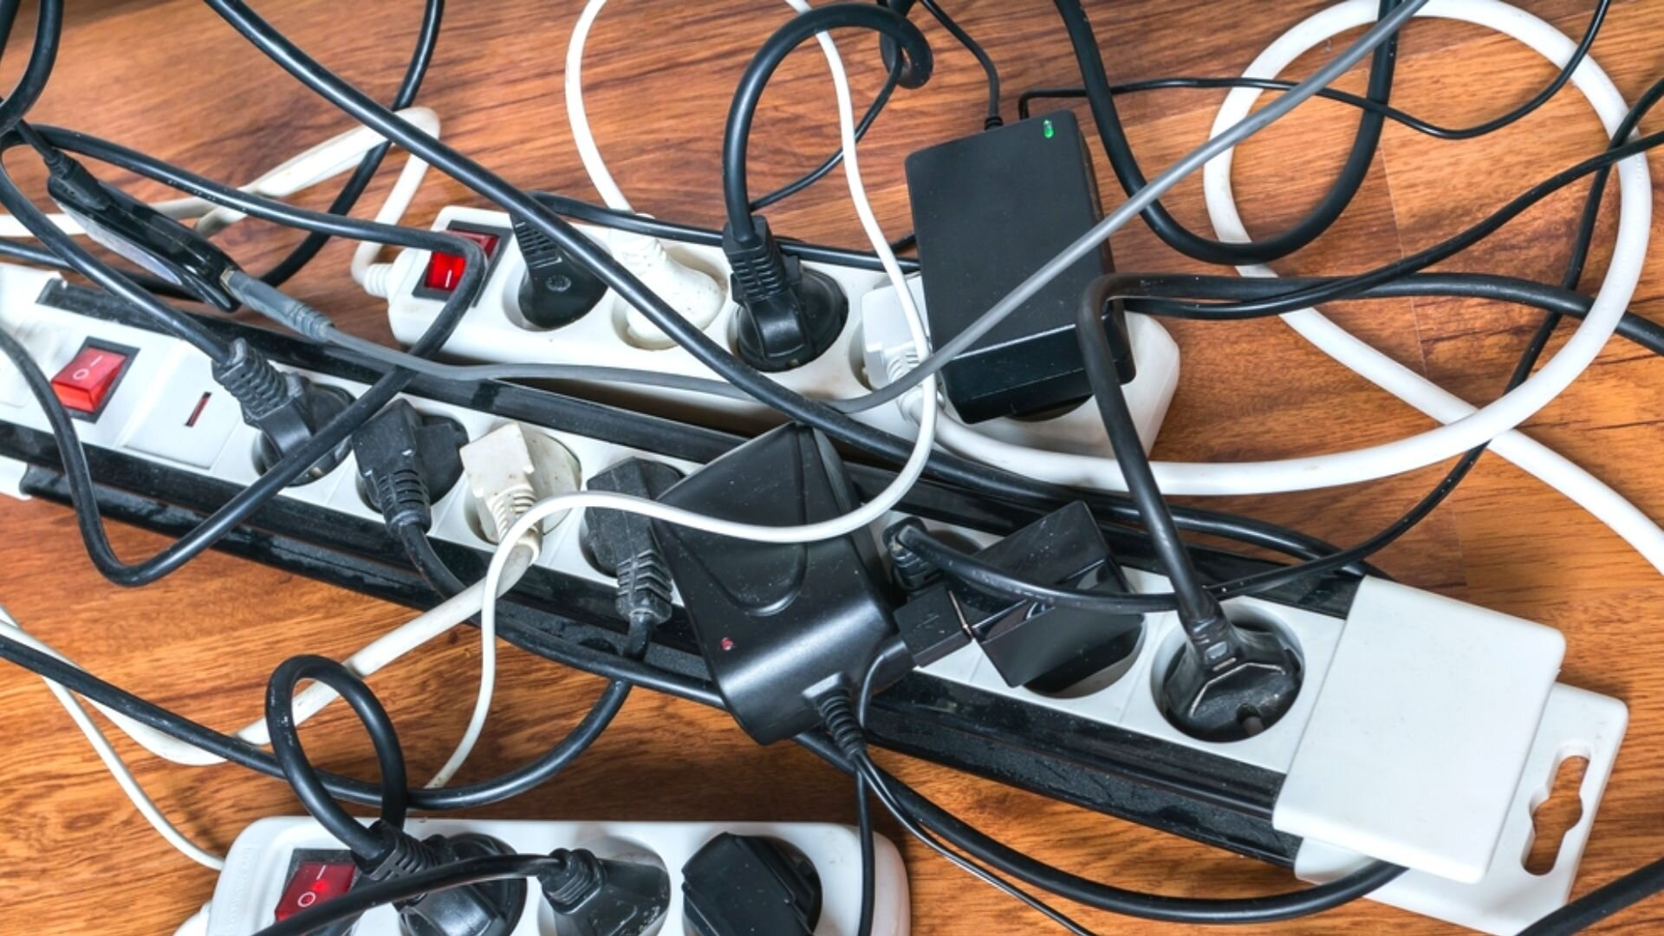
Phase 2 - Connectivity Testing
Conducted Tests: - Confirmed interconnectivity among all machines by using Ping tests and traceroutes performed among all machines - Ensured all Virtual machines could connect to the internet, including the DNS

Slide 7
Phase 3 - Security Integration
Elastic Stack Development:
Installed Elasticsearch for data storage and Kibana for data visualisation
Configured the data sources so we can log any critical events in security
Endpoint Protection:
Established our fleet server and Elastic defend agents to monitor and have proactive defences on all our endpoints
Log Integration:
Forwarded all logs from Palo Alto and Cisco devices to the SIEM for a more centralized analysis

Slide 8
Phase 3 - DMZ Setup and Security Baseline
Configured DMZ Web Server - Installed a LAMP stack to server web applications while isolating it from the internal network. - Applied strict firewall rules to control traffic to and from the DMZ
Security Baseline Established: - Documented compliance with the ASD Essential Eight framework, mostly focusing on…. Regular Patching User account management Network Segmentation

Slide 9
Phase 4 - Testing and Evaluation
Red and Blue Team Exercises
Red Team: Used Karli Linux tools (Nmap, Nikto) to simulate attacks on the infrastructure.
Blue Team: Monitored SIEM alerts, responded to incidents as they occurred.
Analysis and Refinement:
Reviewed logs and incident reports to determine response effectiveness.
Adjusted firewall rules and security policies based on testing outcomes.

Slide 10
Finalising the Project
Comprehensive Documentation - Created a detailed report including all configurations, network diagrams, and testing results

Slide 11
Any questions?
Ask away!

